Slide 1
Angular – High level overview

Slide 2
Schedule
Week 1
Angular Background
AngularJS vs Angular
What is new in Angular?
Week 2
Bootstrap Angular App
Understand various Angular files
Understand routing
Week 3
Learn angular service
Learn angular forms
Form Validation
Week 4
Learn Edit and Delete feature of Form
Unit Testing
Week 5
Unit Testing continued
Code coverage
End-to-End Testing
Package
Week 6
Kinetic Components
Convert existing app to Kinetic
Week 7
Convert existing app to Kinetic continued
Week8
Buffer - If schedule doesn’t go as planed

Slide 3
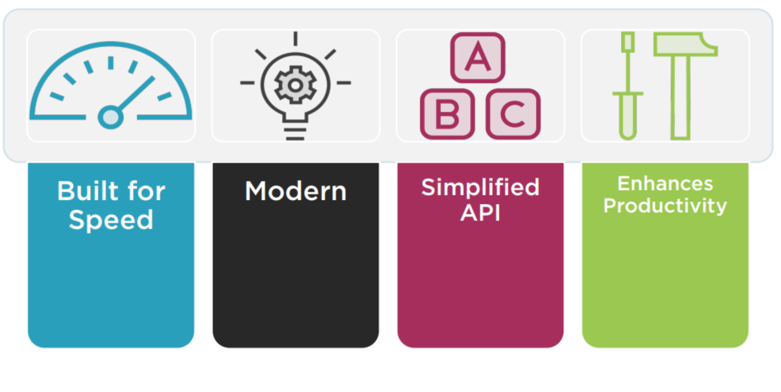
Why a New Angular?

Slide 4
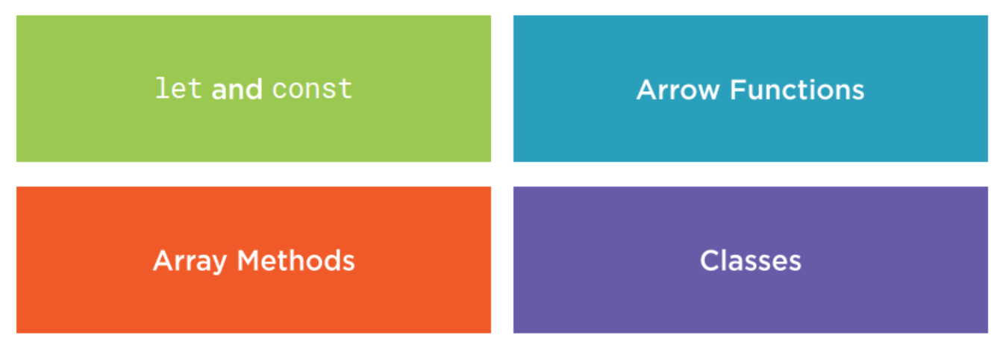
ES2015 (formerly known as ES6)

Slide 5
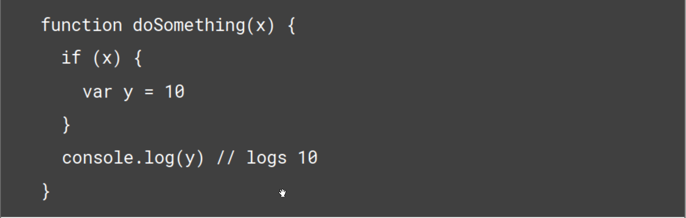
let and const

Slide 6
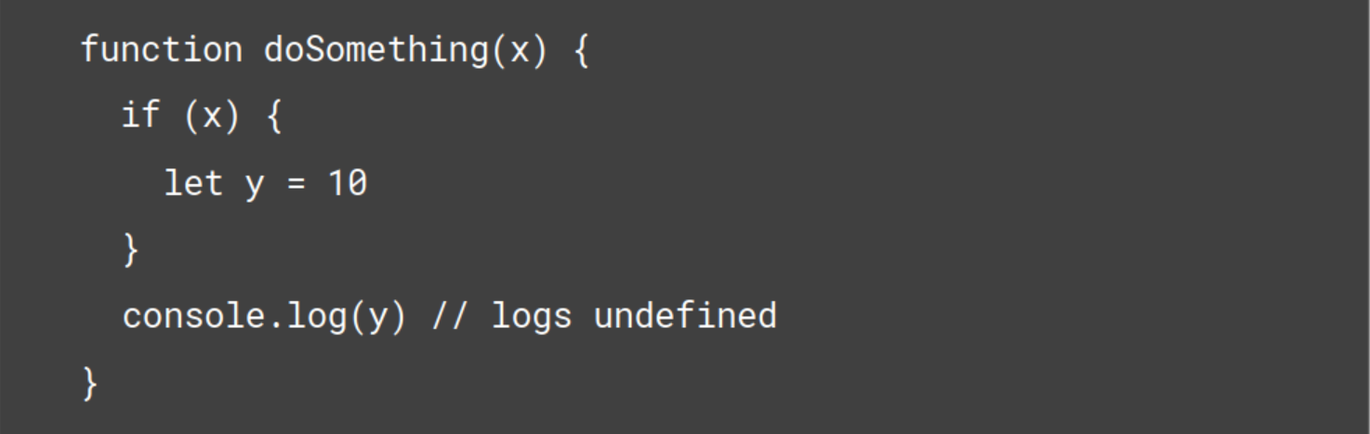
let and const

Slide 7
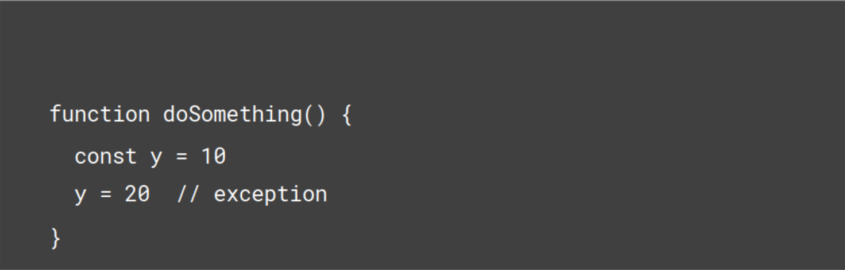
let and const

Slide 8
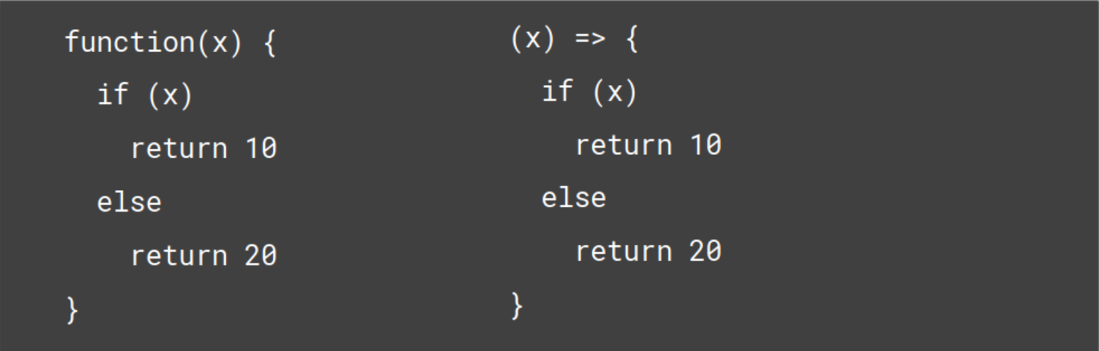
Arrow Function

Slide 9
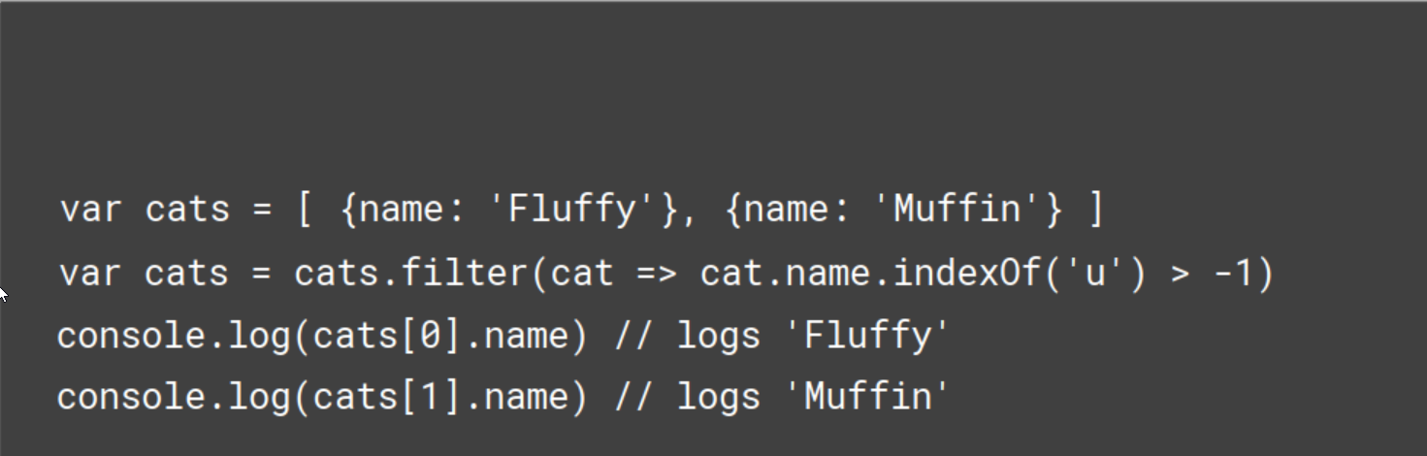
Array methods
Notes:
Many new methods to collection have been introduced in ES6

Slide 10
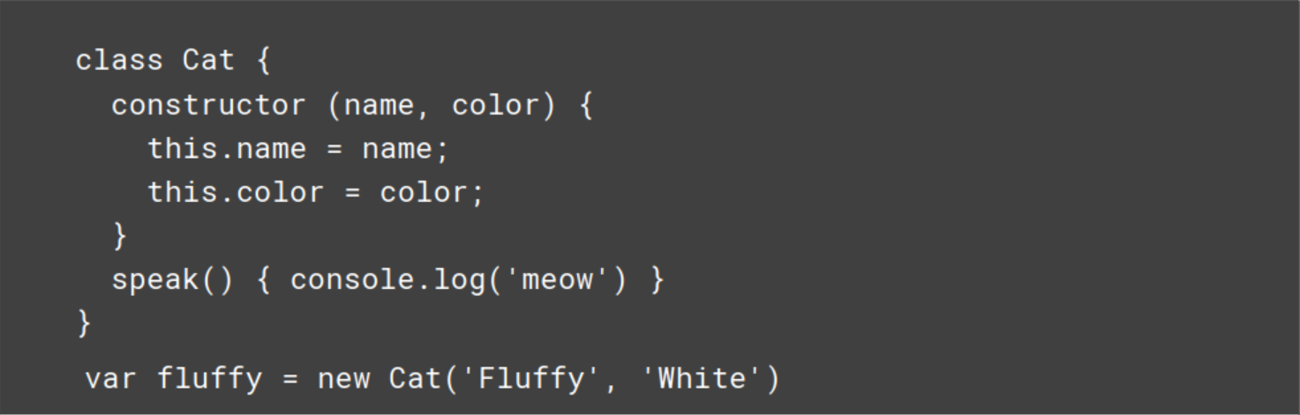
Classes

Slide 11
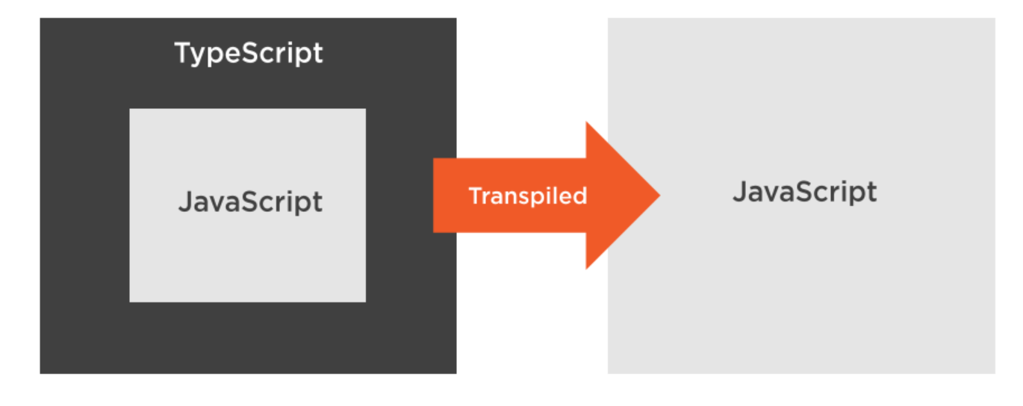
TypeScript

Slide 12
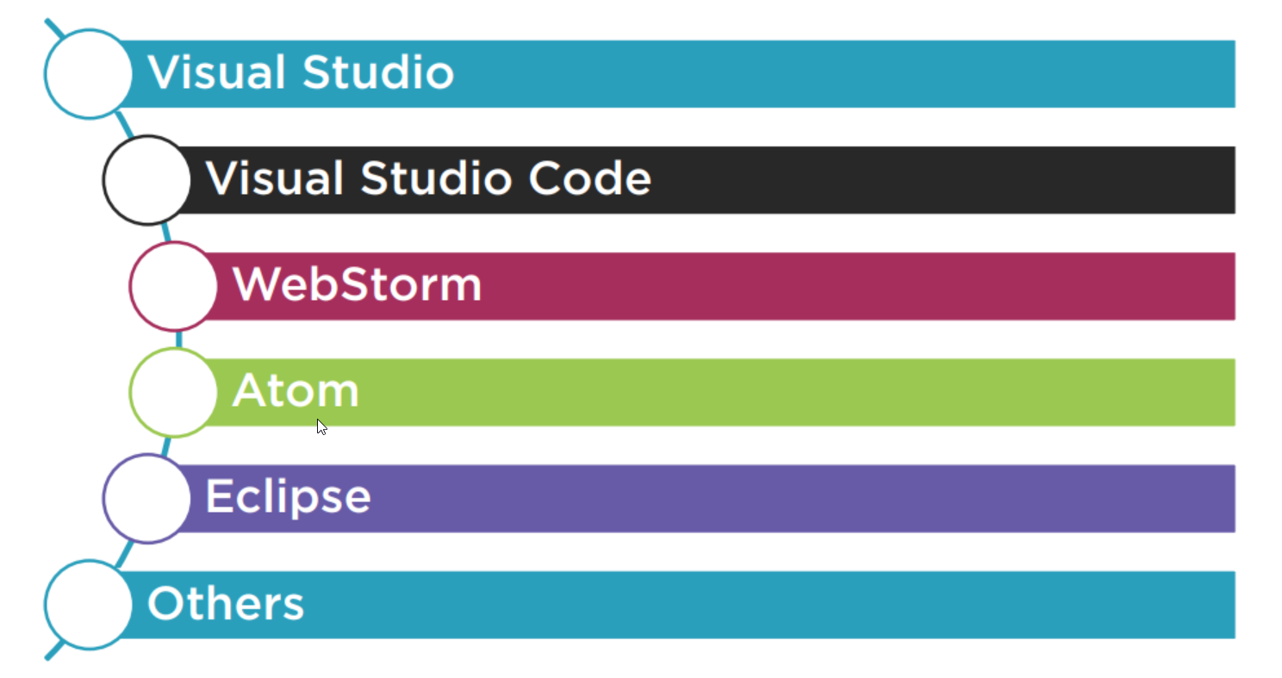
TypeScript Editors

Slide 13
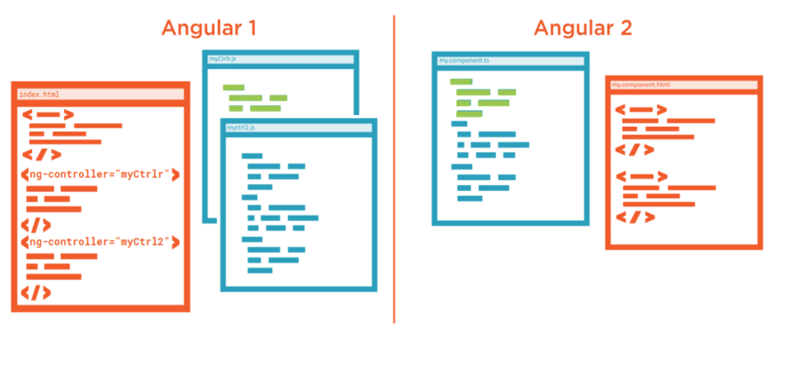
MVC vs Components

Slide 14
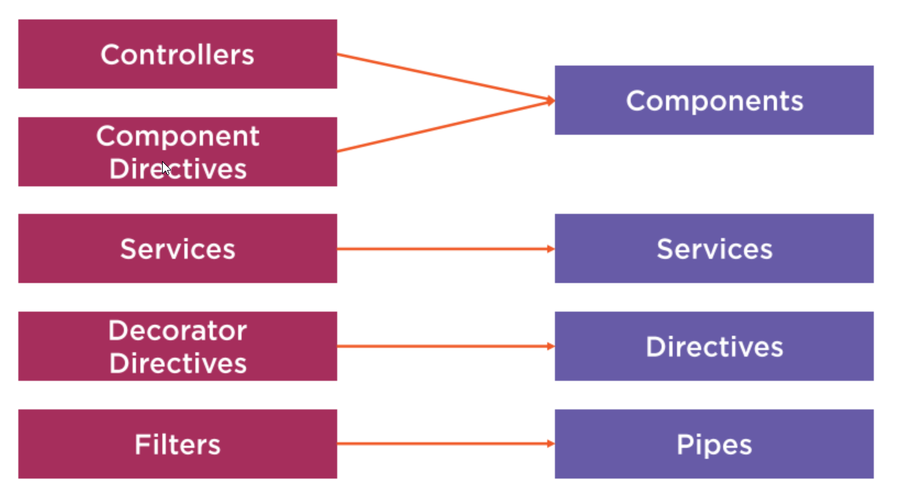
Angular 1 to 2 Mapping

Slide 15
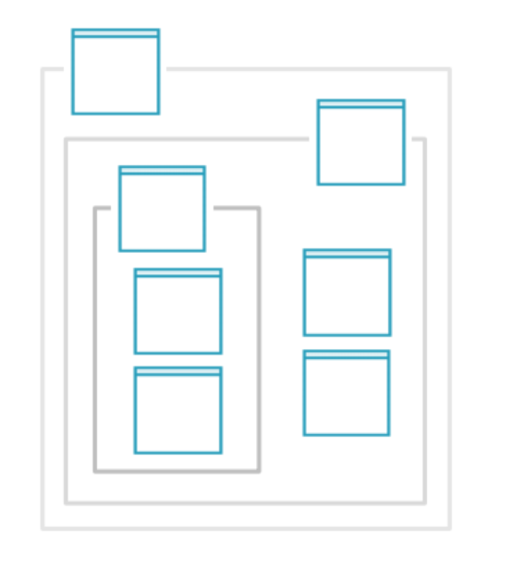
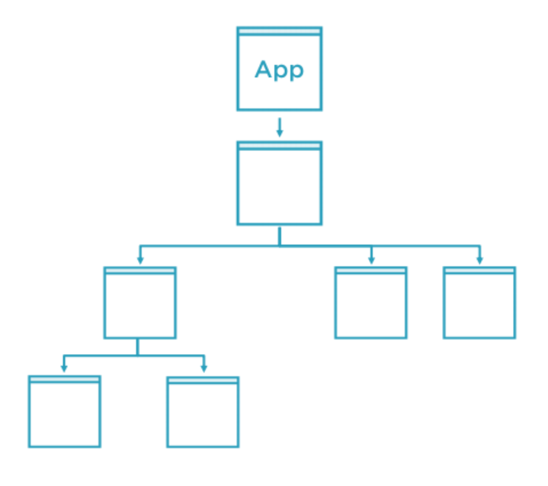
Component Hierarchy

Slide 16
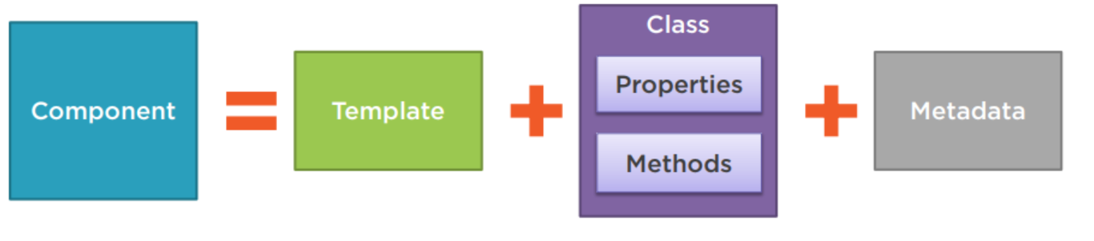
Component

Slide 17
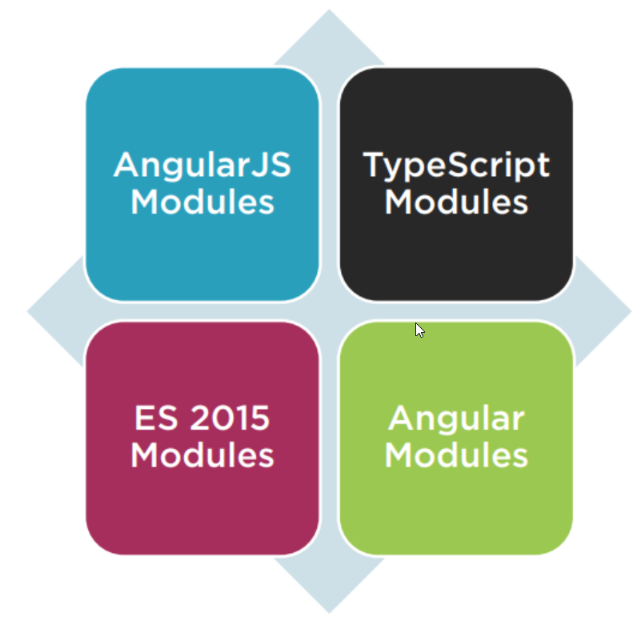
Modules
Code Organization
Namespaces

Slide 18
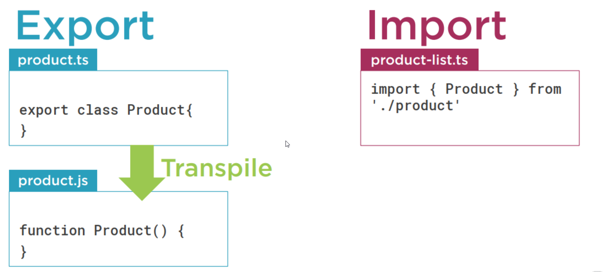
ES 2015 Modules

Slide 19
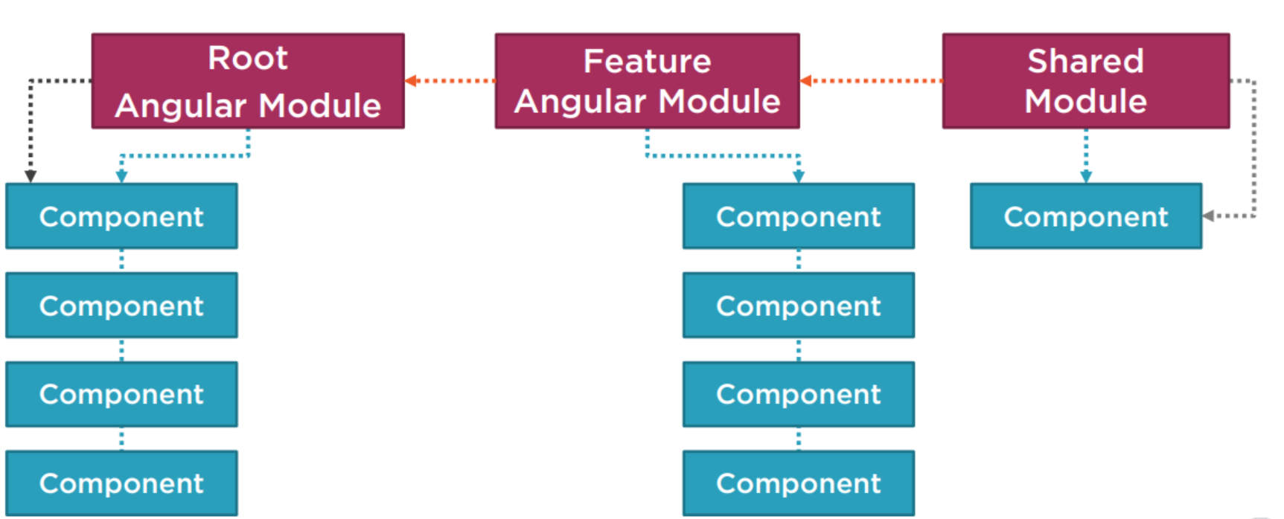
Angular Modules

Slide 20
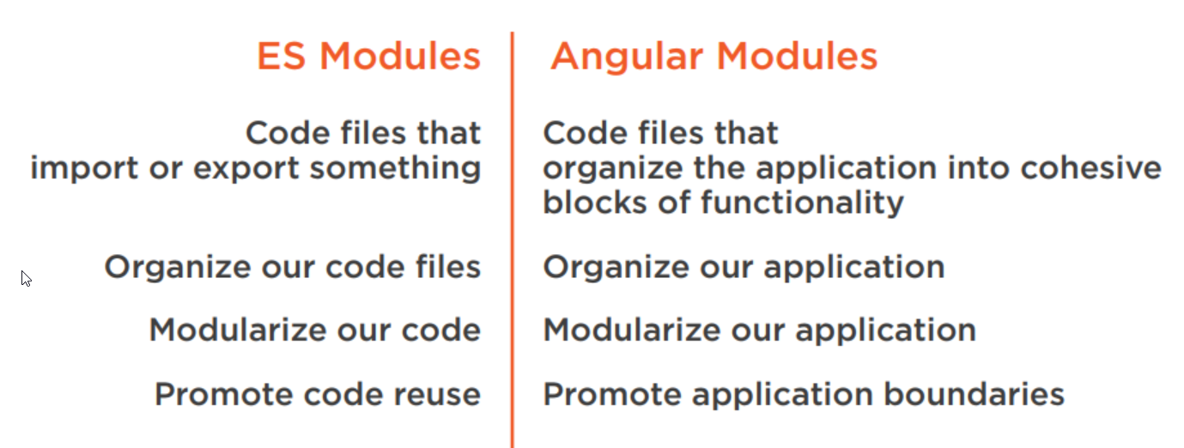
Modules – in summary

Slide 21
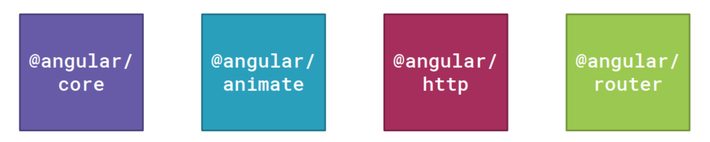
Angular Is Modular

Slide 22
Binding
Coordinates communication between the component's class and its template and often involves passing data.

Slide 23
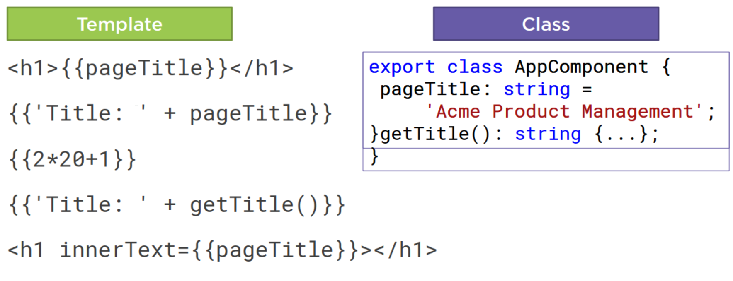
Interpolation

Slide 24
Directive
Directives are markers on a DOM element (such as an attribute) that tell Angular to attach a specified behavior to an existing element.
Custom HTML element or attribute used to power up and extend our HTML.
Custom
Build-in

Slide 25
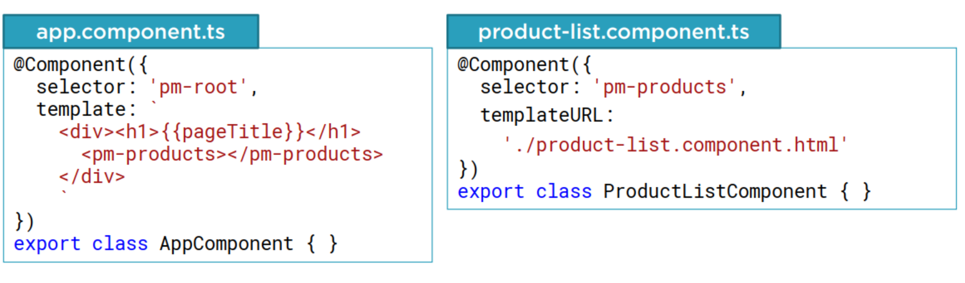
Custom Directives

Slide 26
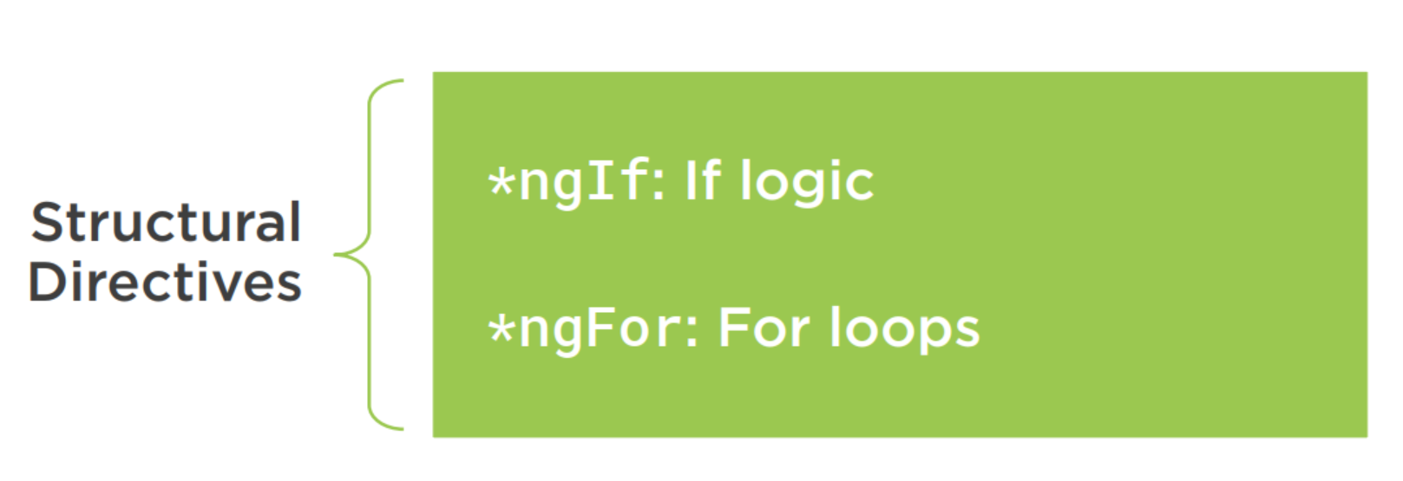
Angular Built-in Directives

Slide 27
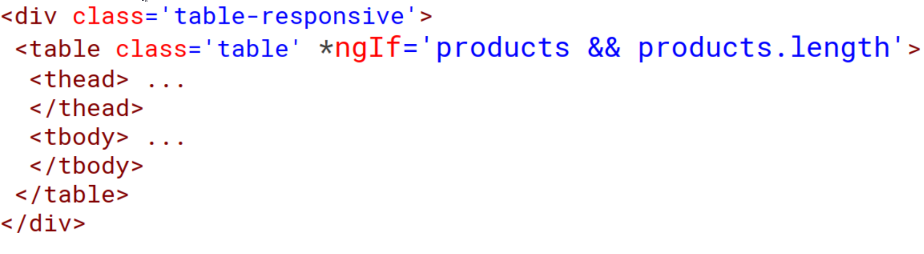
*ngIf Built-In Directive

Slide 28
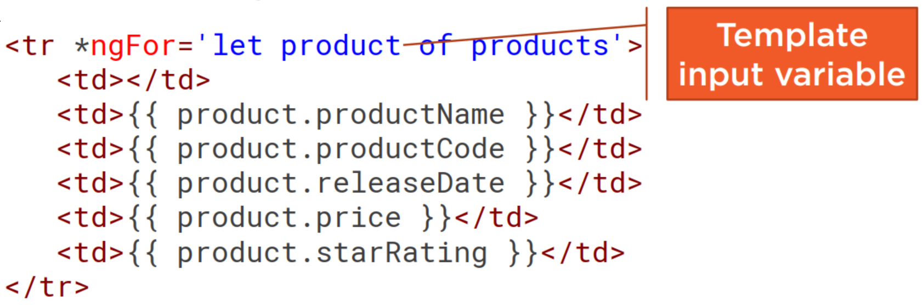
*ngFor Built-In Directive

Slide 29
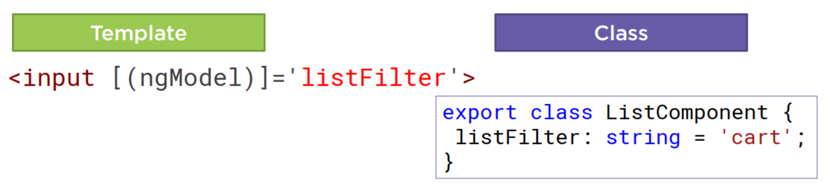
Two-way Binding

Slide 30
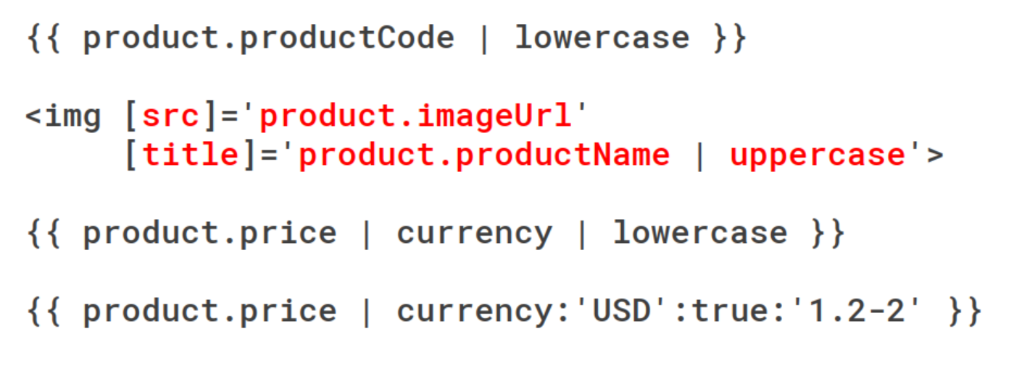
Transforming Data with Pipes

Slide 31
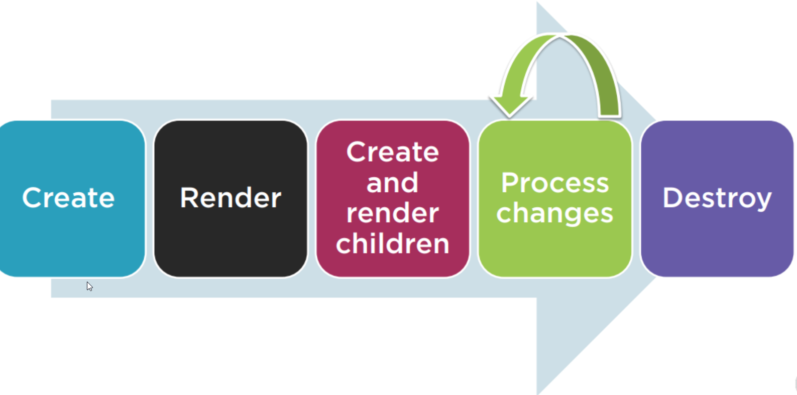
Component Lifecycle

Slide 32
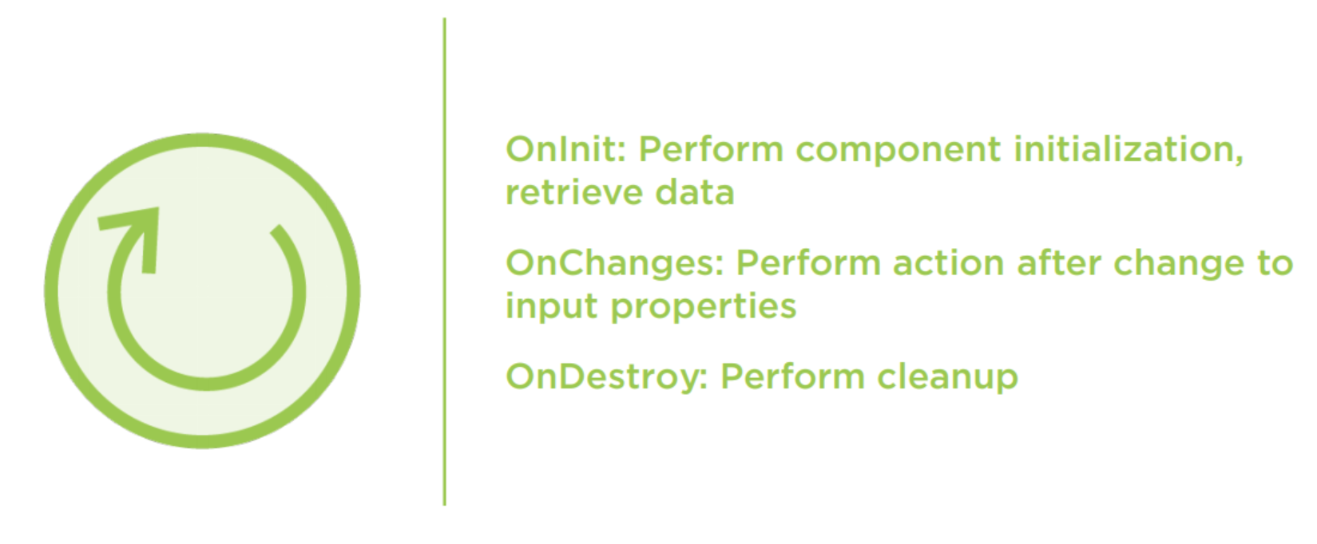
Component Lifecycle Hooks

Slide 33
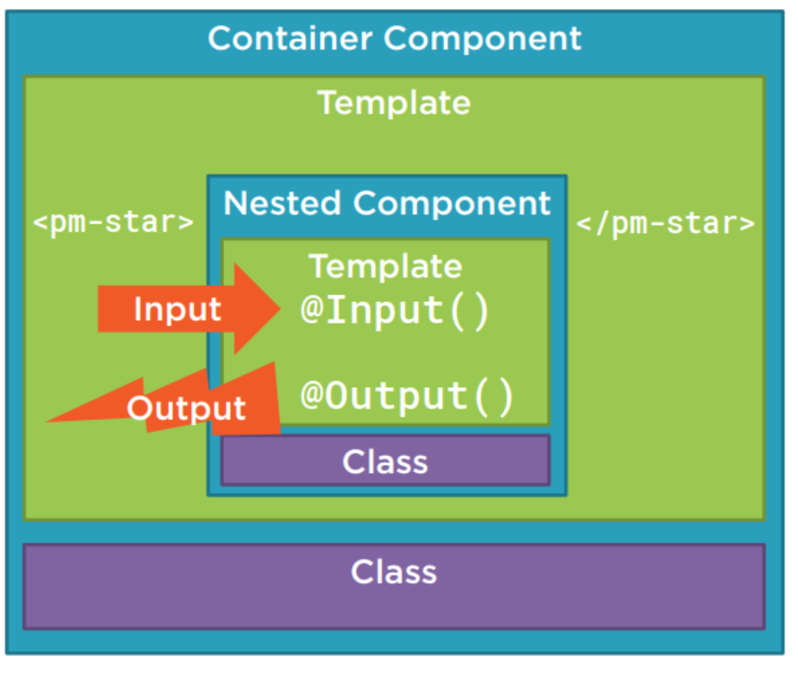
Nested Component

Slide 34
Dependency Injection
A coding pattern in which a class receives the instances of objects it needs (called dependencies) from an external source rather than creating them itself.

Slide 35
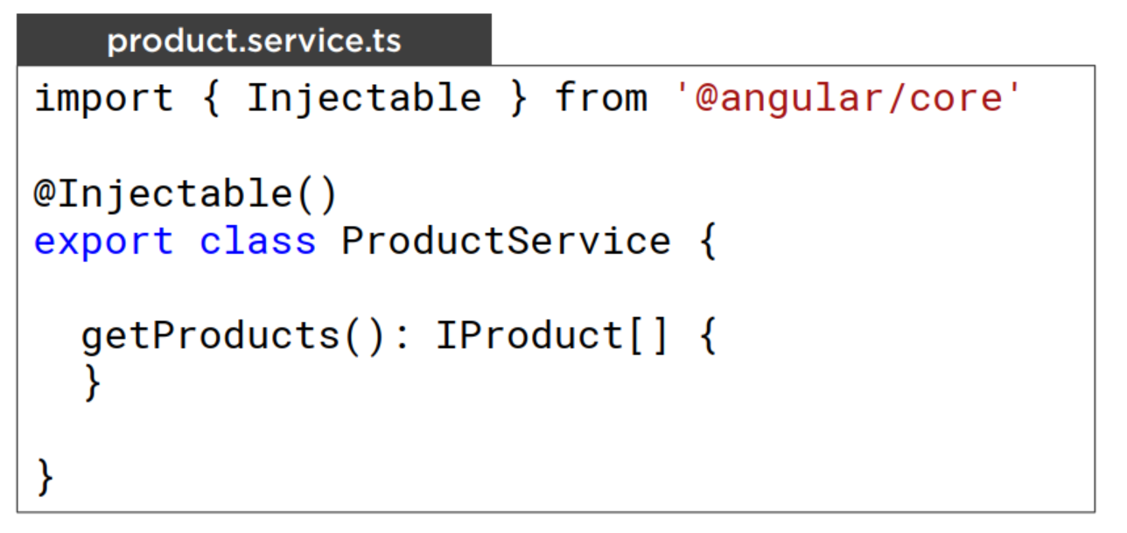
Building a Service

Slide 36
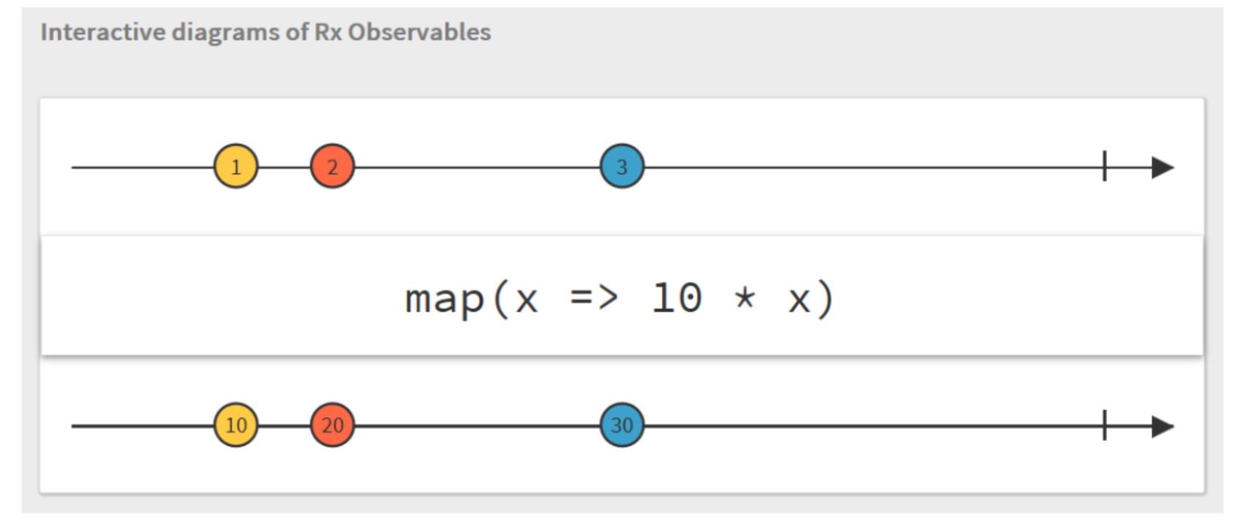
Observables

Slide 37
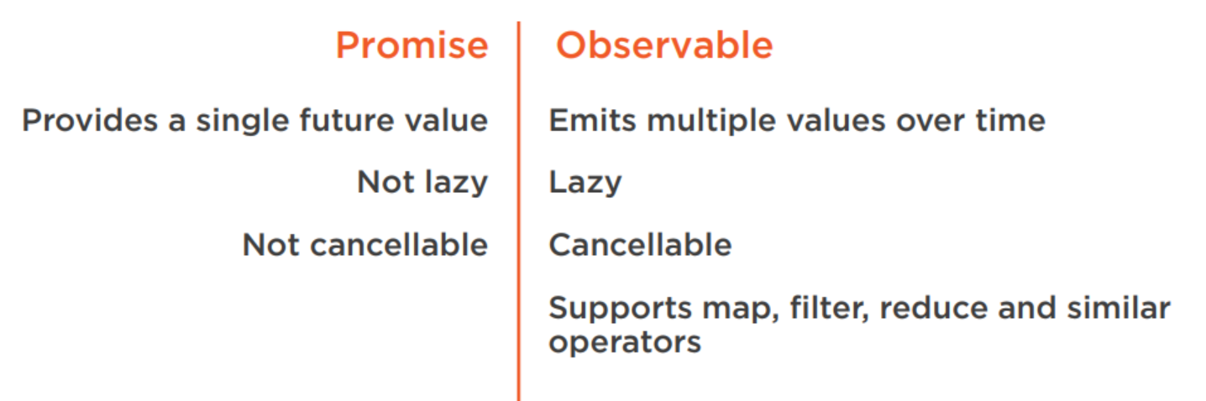
Promise vs Observable
Notes:
https://medium.com/@mpodlasin/promises-vs-observables-4c123c51fe13

Slide 38
Installing the Angular CLI
npm install -g @angular/cli

Slide 39
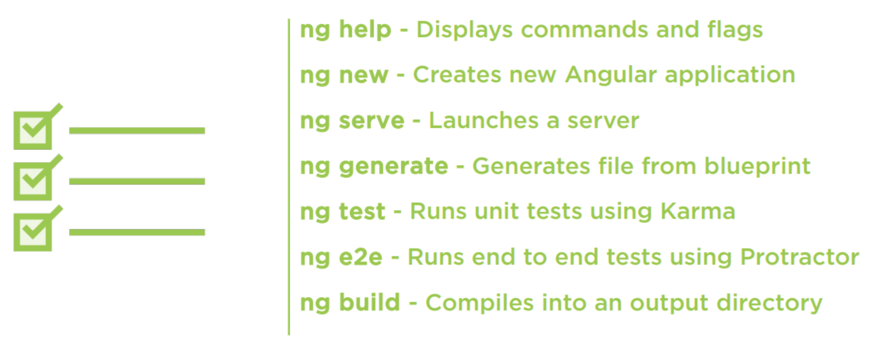
Angular CLI Checklist: Commands

Slide 40
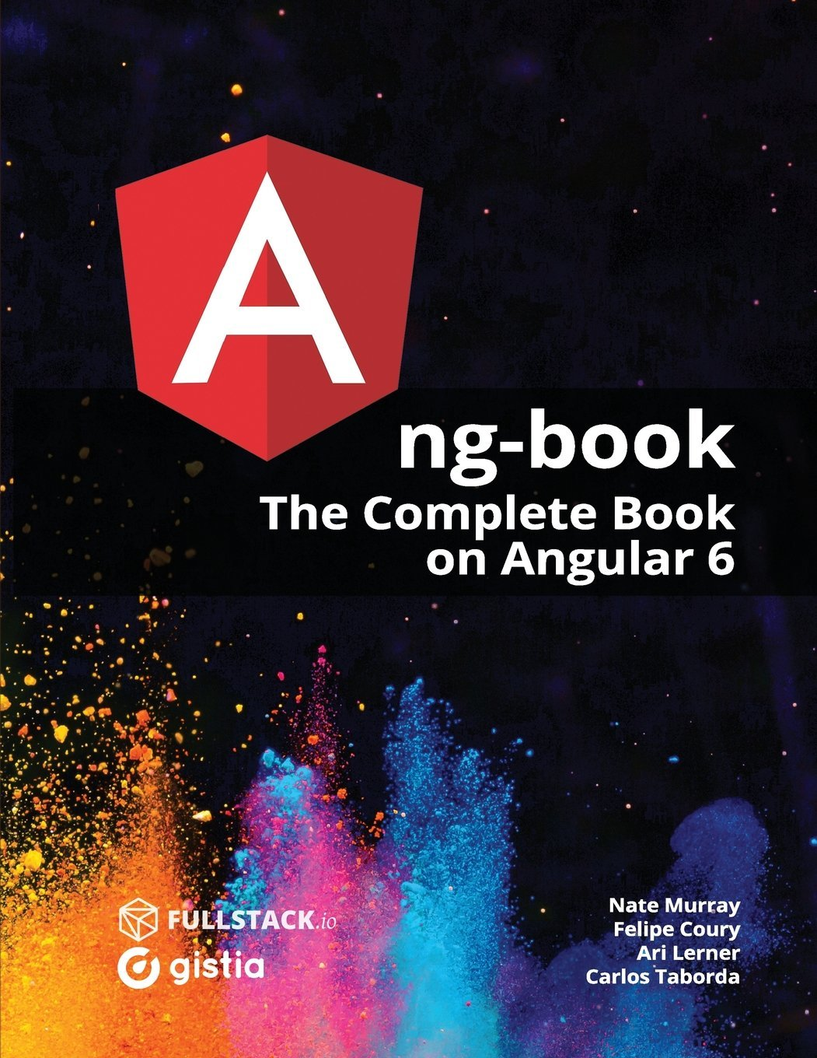
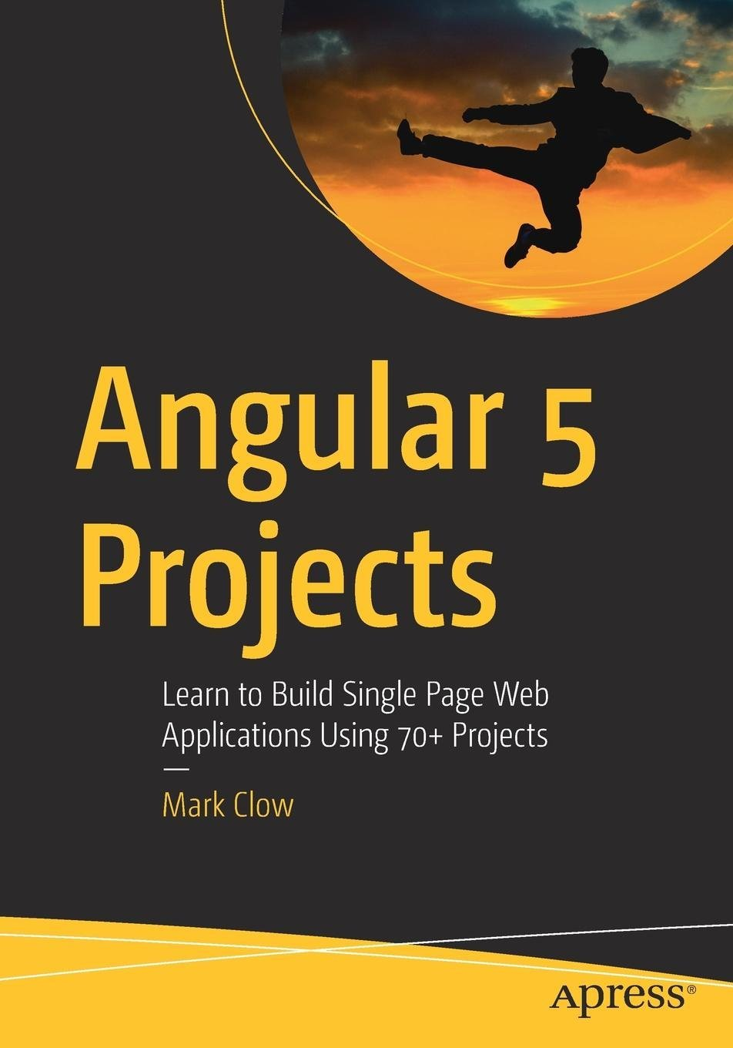
Further reading

